Slide 1



KONGU ENGINEERING COLLEGE
PERUNDURAI ERODE-638060
DEPARTMENT OF
ARTIFICIAL INTELLIGENCE
20ALT52 - Big Data Analysis Project
MARKET BASKET ANALYSIS
Team Mentor: Dr.C.S.Kanimozhi Selvi
Team Members: Jyothi Shri S 21ADR019
Prasshanthini R 21ADR034
Sanjay R 21ADR043

Slide 2
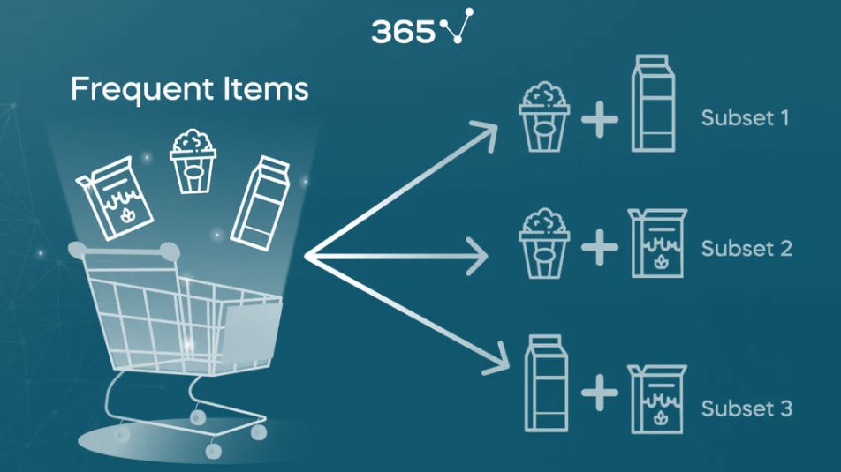
INTRODUCTION
Market Basket Analysis (MBA) is a powerful technique in the field of data mining and machine learning that helps businesses understand the relationships between items purchased by customers.
It is commonly applied in the retail industry to uncover patterns and associations within transactional data
In this introduction, we will explore how hyperparameters play a vital role in enhancing the effectiveness of Market Basket Analysis.
Notes:
MBA aims to answer questions like, "If a customer buys product A, what is the likelihood they will also purchase product B?"

Slide 3
PROBLEM STATEMENT
Inefficient Inventory Management: Without a clear understanding of which products are frequently purchased together, businesses may struggle, leading to overstocking or understocking issues.
Missed Cross-Selling Opportunities: Failing to identify complementary products can result in missed opportunities for cross-selling and upselling, which can directly impact revenue.
Suboptimal Marketing Strategies: Ineffective product recommendations and marketing strategies leading to lower customer satisfaction and loyalty.
Complex Data Analysis: Analyzing vast transaction datasets can be challenging and time-consuming, making it essential to streamline the Market Basket Analysis process.

Slide 4
OBJECTIVE / OUTLINE
Objective is to generate association rules, that helps organization predict which all products are bought together.
Application of FP Growth algorithm is used.
DATA LOADING
Market Basket Analysis data of year
2009 – 2010 & 2010 – 2011 were loaded.
7 different preprocessing steps were done for both the records (mentioned above).
PREPROCESS
FP Growth and Association Rule mining are used with and without hyperparameter tuning and pipeline.
ALGORITHMS

Slide 5
PREPROCESSING
Data Exploration
Column Rename
Drop NULL values
Remove Duplicates
Splitting Columns
Type Conversion
Remove Cancelled Orders

Slide 6
ALGORITHMS USED
FP Growth :
A frequent itemset mining algorithm used to discover frequently occurring patterns in large datasets.
Association Rule Mining :
Association rule Mining is a rule based machine learning method for discovering interesting relations between variables in large databases.

Slide 7
ACCURACY METRICS
Support: The frequency of a specific itemset in the dataset.
Confidence: The probability that customers who bought item A also bought item B.
Lift: The measure of how much more likely item B is purchased when item A is purchased compared to when item B is purchased independently.
Unlike classification and regression tasks, association rule mining are not typically evaluated using accuracy.

Slide 8
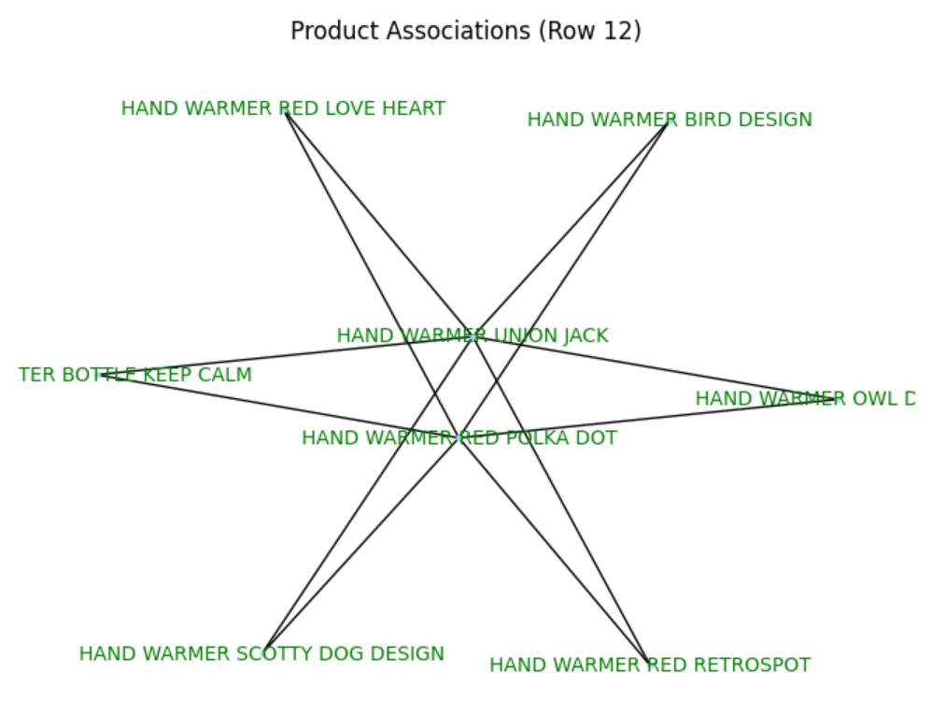
WITHOUT PIPELINES
SUPPORT : 761
CONFIDENCE : 567
LIFT : 3884
NO.OF RULES = 3924

Slide 9
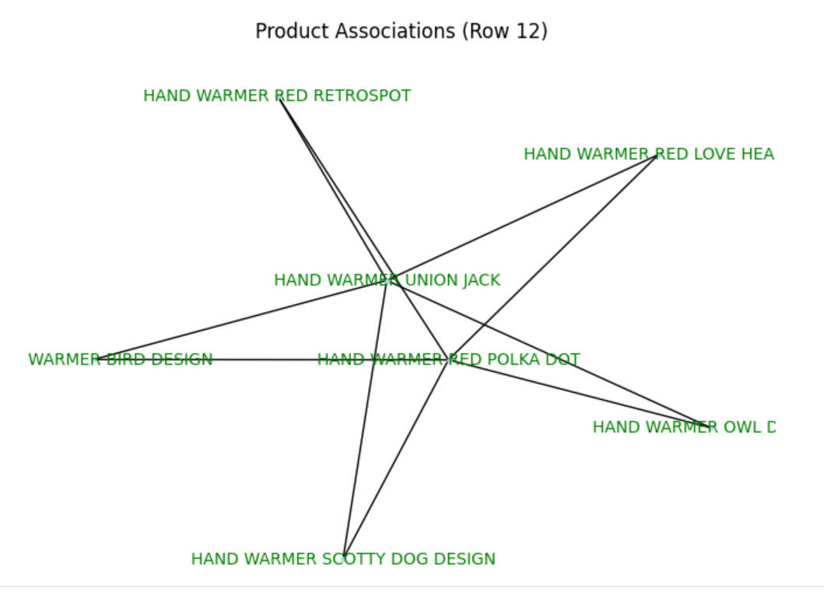
WITH PIPELINE AND HYPER PARAMETER TUNING
SUPPORT : 761
CONFIDENCE : 200
LIFT : 1650
NO.OF RULES = 1656

Slide 10
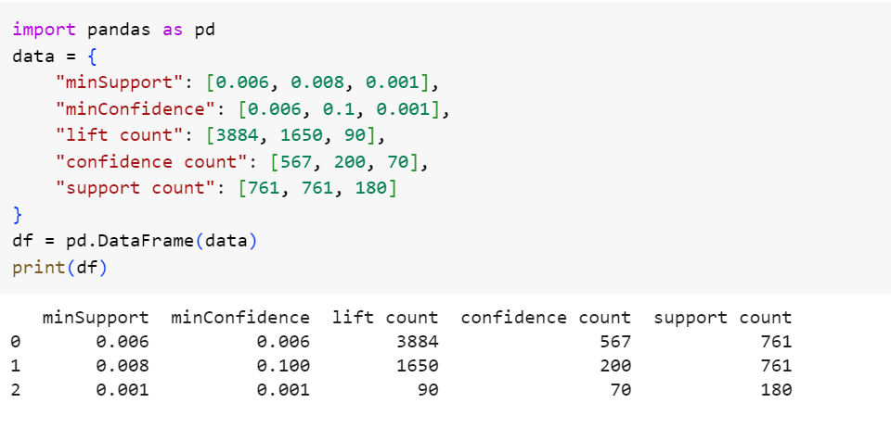
COMPARISON

Slide 11
CONCLUSION
Thus, Market Basket Analysis (MBA) emerges as a valuable tool for businesses seeking to unlock the hidden potential in their transaction data and address the challenges they face in the highly competitive retail environment.

Slide 12


